Slide 1
An Update from Washington
Presented by
The Franklin Partnership, LLC
October 8, 2020

Slide 2
Your Team in Washington, D.C.
Lobbying Firm – The Franklin Partnership, LLC
Bi-partisan Washington, D.C.-based government relations firm
Representing manufacturing industry since 2002
Clients include: manufacturing associations, defense contractors, hospitals, cities
Strategic Communications Firm – Policy Resolution Group at Bracewell
Wash, D.C.-based public affairs & strategic communications consultants
Promote NTMA and PMA in print, digital and other media
Support Franklin Partnership government relations efforts by designing and implementing coordinated strategic communications strategy
Representing metalworking industry since 2003
Nothing contained in here shall be deemed legal advice.

Slide 3
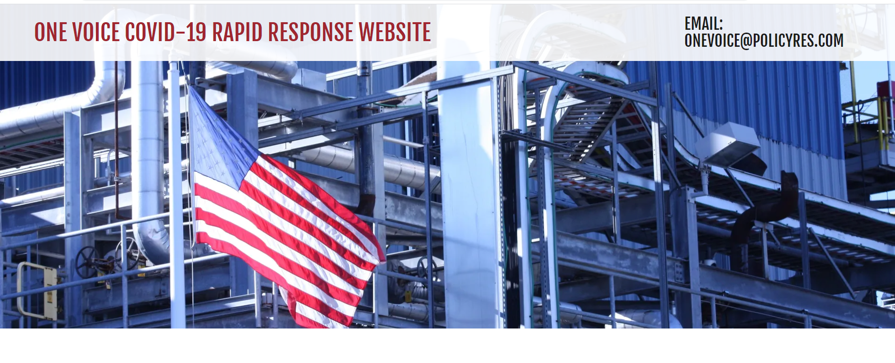
More Resources: www.onevoiceinfo.org

Slide 4
NTMA/PMA Podcast – Subscribe Now!
Available on:
l Apple Podcasts
Google Podcasts
Spotify
Stitcher
Soundcloud

Slide 5
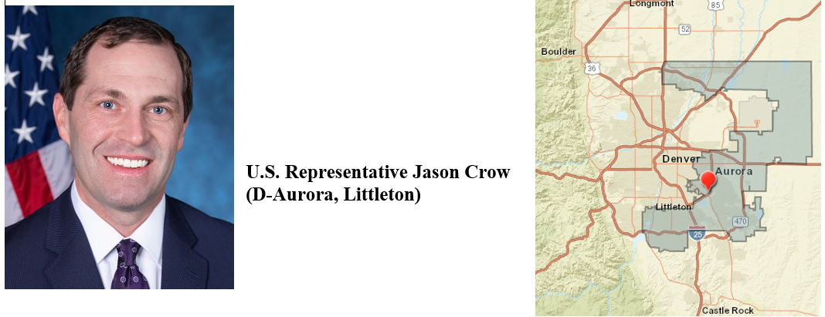
Rocky Mountain Virtual Mtg – Congressman Crow
Tuesday, October 13 1:00pm Mountain
Contact Kaity - chapterexec@rmtma.org

Slide 6
State of Washington – Tense
Pelosi and Trump have not spoken since October 16, 2019
Politics dictates process and drives policy
Who benefits politically from another bill?
President Trump’s reelection chances
5-6 vulnerable Senate Republicans as helps McConnell retain Senate control
15-20 moderate House Democrats in the 30 Congressional Districts that voted for Trump in 2016
Who does not benefit politically from another bill?
Joe Biden, Democrats who want to defeat President Trump and not hand him a victory days ahead of Nov. 3
Sen. Schumer who is poised to take control of the Senate if Democrats win doesn’t want to give GOP a win
Politics Aside, Policy Differences Remain but some agreement
Trump wants another round of stimulus checks to voters, Democrats agree but not as stand alone bill
Democrats want funding for state, local governments and schools, GOP opposes proposed levels
Largely agree on unemployment insurance, Paycheck Protection Program (PPP) loans; Second PPP

Slide 7
COVID-19 Relief Legislation – Next Step Scenarios
President Trump re-elected, GOP holds Senate: COVID-19 vote likely in December with robust “lame duck” legislative activity;
President Trump re-elected, Democrats win Senate: McConnell tries to press through a vote, unclear Pelosi would allow COVID-19 bill as will have more leverage with a Democratic controlled Senate in 2021;
President Trump defeated, GOP holds Senate: Depending on the President, Republicans will want to put their imprint on any final bills in the lame duck despite Speaker Pelosi wanting to wait for Biden swearing in, still a good chance of COVID-19 relief;
President Trump defeated, Democrats take Senate: Little chance of a vote on COVID-19 relief bill as Democrats will have a “trifecta” – the White House, Senate, U.S. House and can write their own bill in late January/early February that includes “revenue raisers.”

Slide 8
Policy Outcomes Based on November Political Results
Scenarios for a second Trump term vs a Biden administration

Slide 9
Trump vs. Biden: Job Training
Note: Significant policy changes require Congress to pass a bill likely with 60 Senate votes
Issue | Trump Administration II | Biden Administration
Higher Education Act | Passes Congress if no vote in 2020 | Passes Congress if no vote in 2020
National Apprenticeship Act | Battle with Congress over IRAPs | Bill passes by end of 2022
Industry Recognized Apprenticeship Program (IRAP) | Continue Standards Recognition Entity (SRE) certifications | Pause/cancel IRAP program or make significant changes to audit standards
Job Training Funding/Grants | President’s Budget will continue to cut funding but will sign increased spending bills | Increased funding for MEPs, TAA, WIOA, CTE, minority/women/youth training grants; focus on unions
College Transparency Data | Continue to publish data | More interested in access to college
Community Colleges | Continue to emphasize public-private partnerships | Increased role for community colleges in training and preparing students for work
Industry Partnerships | Continue to emphasize public-private partnerships | Emphasize industry, association should partner with unions
Work-based Learning | Expand opportunities | Include livable wage requirement
K-12 Curriculum | Continue business involvement | Focus on broadband access/learning tools

Slide 10
Trump vs. Biden: Human Resources Policy
Issue | Trump Administration II | Biden Administration
Federal Minimum Wage | Slight increase possible | Increase possible depending on Congress
Increase Overtime Threshold | No change for 2-3 years | Regular increases through regulatory changes
FMLA Expansion of Paid Leave | Some expansion likely | Yes for employee and dependents
EEOC Reporting | Fights Court Orders to release detailed EEOC data | Seeks to expand data reported, released
Union organizing votes | Restrictions expand | Revert to Obama-era policies – short term voting, harder to decertify, easier to organize
Affordable Care Act | Focus on Rx pricing | Revert to original Obamacare, expand coverage options, lower Rx pricing
Marijuana Legalization | No new guidance for employers, need DoJ to go along | Indicated no change for now, less federal enforcement
OSHA Inspections | Continue to increase, try to cooperate with businesses | Emphasis returns to pre-COVID PPE (hearing, inhalation, heat exposure requirements)
State Regulations | Significantly Accelerate on their own | Coordinate with federal government

Slide 11
Trump vs. Biden: Environmental Regulations
Please note many environmental regulations are subject to court review, often reversed, blocked
Issue | Trump Administration II | Biden Administration
Expedite Environmental Review Process for Infrastructure Projects – NEPA | Continue expedited process to limit time to review projects prior to approval | Maintain lengthier review with additional factors for consideration
Cost-Benefit Analysis | Limit non-economic factors during rulemaking | Include social cost of carbon, public health impact in rulemaking
Ground Level Ozone – NAAQS | Maintain current 70ppb levels | Possibly lower to 65ppb
Particulate Matter 2.5 Level – NAAQS | Maintain current levels | Lower permissible 8 hour limit
Auto emissions | 1.5% annual increase | Up to 5% annual increase; State rights
Heavy Duty Truck Emissions – NOx | Tighter standards expected | Could align with California standards
Power Plant Regulations | Regulate “inside-the-fenceline” | Revert to Obama secondary impact policy
Scientific Review Panels | Continue limiting studies, make reviews public | Rely on science panels; Results, reviewers often not fully made public
Waters of the U.S. | Continue to limit EPA jurisdiction | Revert to Obama policy, expand EPA power

Slide 12
Trump vs. Biden: Taxes
Note: Major changes to tax rates or policy require Congress to pass a bill with 51 or 60 Senate votes
Issue | Trump Administration II | Biden Administration
21% C-Corporation Rate | No Change unless funds needed for future COVID stimulus | Campaign says 28%; if Congress has votes to act, could see increase up to 28% (25% possible)
37% top individual rate | No change until 2025 | If Democrats control House, Senate, top rate 39.6% returns for highest earners
Individual Tax Rates | If GOP holds Senate, could realign brackets for middle class cut | If Democrats control House, Senate, increase number of brackets
199A 20% QBI Deduction | On schedule to end Dec. 31, 2025 | Narrow eligibility for high earners and high wealth; Phase out for high earners
Payroll Tax | Will seek a holiday for 2020, Congress would have to pass a bill | Impose a Social Security surcharge tax on higher earners
Net Operating Loss | No Change | Narrow CARES Act, limit which years
Capital Gains | Attempts to index to inflation | Treats as ordinary income for top earners
Itemized Deductions | Increase standard deduction | Cap deductions at 28% for high earners
Estate Tax | On schedule to revert Dec. 31, 2025 | Lower exemption level from $11.58m to $5.49m
Expect tax increases in some form as part of a 2021 economic stimulus bill, especially under Biden but also Trump

Slide 13
Current State of Trade
Ongoing Trade Battles
China
Europe Aviation
Europe Digital Tax
Australia?
Vietnam?
Steel, Aluminum
Canadian steel
Autos, auto parts
Washing Machines
Solar panels
Semiconductors
Rare Earth Elements
Pending Trade “Agreements”
India
Kenya
UK
Resolved Trade “Disputes”
South Korea
Japan
NAFTA
China Phase I
Notes:
Omar

Slide 14
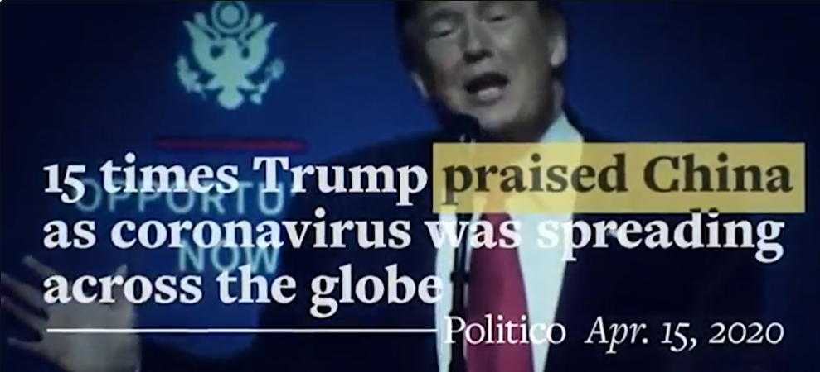
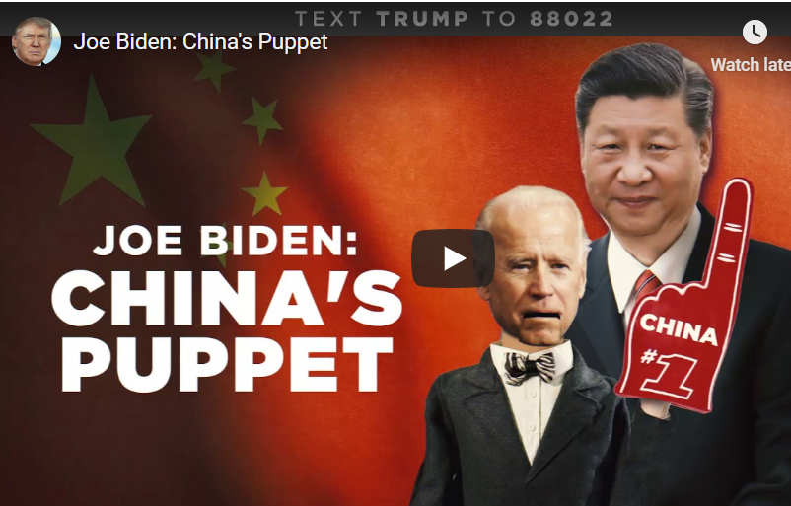
2020 Campaign: Who is More Pro (Anti) China
Strategically, Biden needs to be more anti-China/appear stronger than Trump
Both campaigns view China as a vulnerability for the other
In 2016, Trump won Michigan, Pennsylvania, Wisconsin by being anti-trade (China)
If Trump wins AZ, FL, NC, ME, Biden must win all three MI, PA, WI
The campaigns are already running advertisements focusing on China:

Slide 15
Trump V. Biden U.S.-China Relations
Trump likely content to leave China tariffs in place for entire second term
Tariffs are leverage and unless he secures a new large deal, no incentive to lift tariffs
Those around Trump want a fundamental realignment of supply chains, changes from China on IP theft, subsidies
Executive action with congressional support to incentivize suppliers to leave China and penalize those who do not
Expect status quo, tariffs through 2022 as Trump focusses on countries where he can make a deal
Biden will quickly work to build a global coalition to challenge China
Tariffs on China likely remain through 2021 and very likely up to 2022 November election
Like them or hate them, tariffs are leverage over China Biden would inherit
Could, however, see narrowing of tariff list to remove direct consumer goods
Expect industrial policies to incentivize business to leave China
Trump has little focus on human rights, Hong Kong; Biden will focus on HK, Taiwan

Slide 16
Trump vs. Biden: Trade
Issue | Trump Administration II | Biden Administration
China 7.5% / 25% Tariffs | Remain in place through 2022 | Remain in place at least through 2021
25% Steel Tariffs / 10% Aluminum Tariffs | Remain in place until deals reached with each country subject to tariffs | Lifted in 2021 on allies (EU, Japan, etc.)
Auto, parts tariffs | Threat remains in place | No broad Section 232 auto tariffs
Boeing-Airbus Dispute | Tariffs remain until EU deal | Dispute resolved; Tariffs lifted in 2021
EU and France Digital Services Tax 301 Tariffs | If no deal, tariffs imposed | No tariffs, attempt to establish OECD global corporate minimum tax
Trade Agreements | Negotiations with UK, EU, Kenya, Japan mini-deal II | New trade agreements unlikely in 2021; AGOA, Caribbean Basin action possible (if not done in 2020)
Sanctions on China, Export Controls | Yes, to force supply line changes, protect technology | Yes, to pressure on human rights, protect technology
Supply Chains | Sanctions, tariffs to force companies to leave China | Higher taxes on offshoring, incentives for onshoring (taxes need Congressional)
Rare Earth Elements | Tariffs on imports; Increase domestic mining | Develop partnerships with trusted allies
Policymakers moving faster on supply chain realignment than companies – do not get caught off guard

Slide 17
Road to the White House – A Pathway for Each
How Trump Wins
Vaccine, treatment rolled out before election; economy rebounds; schools safely open
A choice between liberal socialists and law and order
Depress enthusiasm for Biden among Black voters; reassure voters over 65; Maximize evangelical turnout
Challenges for Democratic voters in certain suburban areas of toss-up states
Squeeze every last voter out of rural counties
Label Biden a typical politician, back to Washington business as usual
How Biden Wins
Election is a referendum on Trump handling of COVID
Economy does not recover, no positive signs
Additional disclosures of COVID response mismanagement
Turn moderate “Romney Republicans” to Biden; switch older voters over 65 from Trump to Biden
Generate energy among young voters, minorities, suburban women – Supreme Court mobilization
Trump wants this to be a “choice” election Biden needs it to be a referendum on Trump

Slide 18
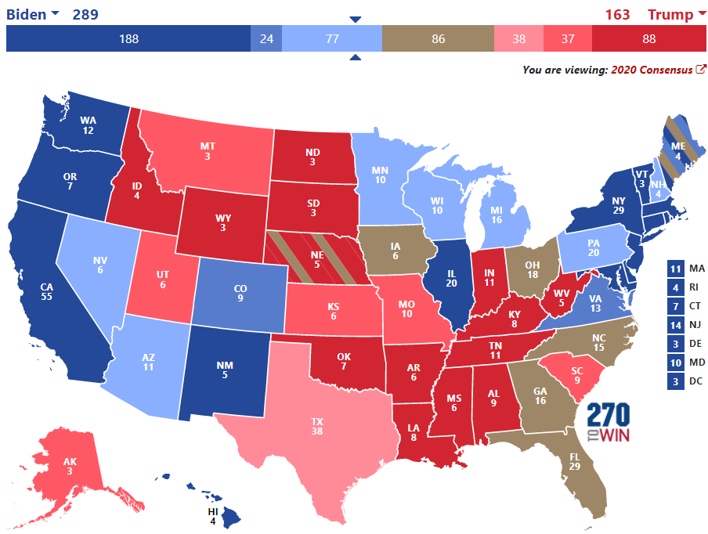
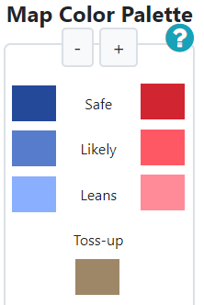
Where Will the Battle Be Won? The States in Play
https://www.270towin.com/

Slide 19
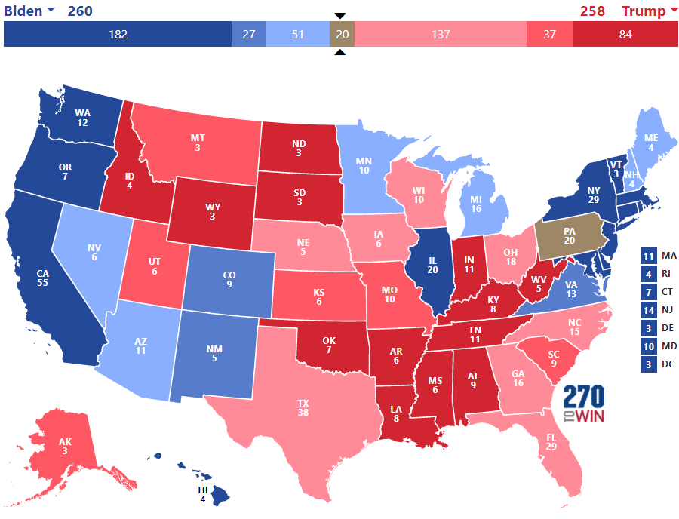
My Map Prior to Trump’s COVID Infection
https://www.270towin.com/

Slide 20
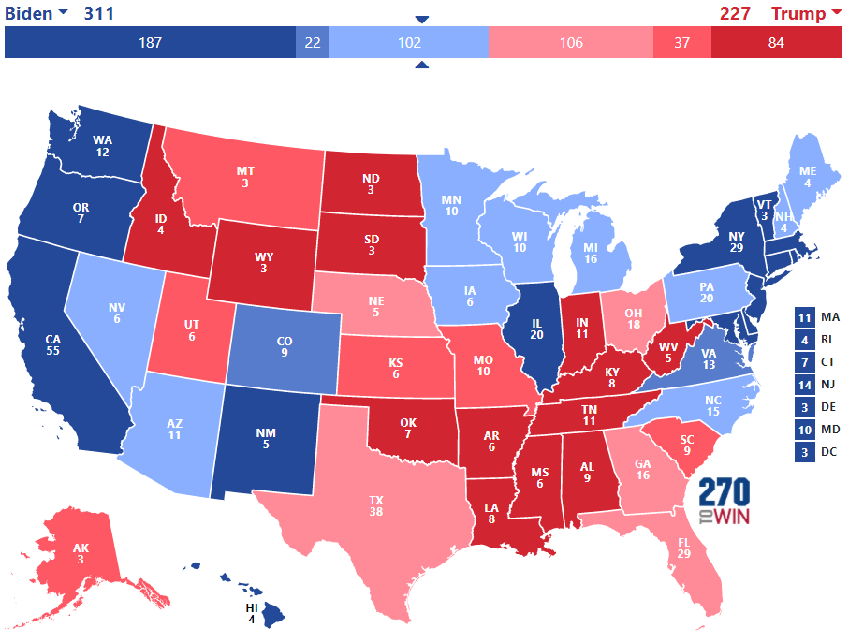
My Map Following Trump’s COVID Infection
https://www.270towin.com/
As of Oct 7, 20202 2:14pm…

Slide 21
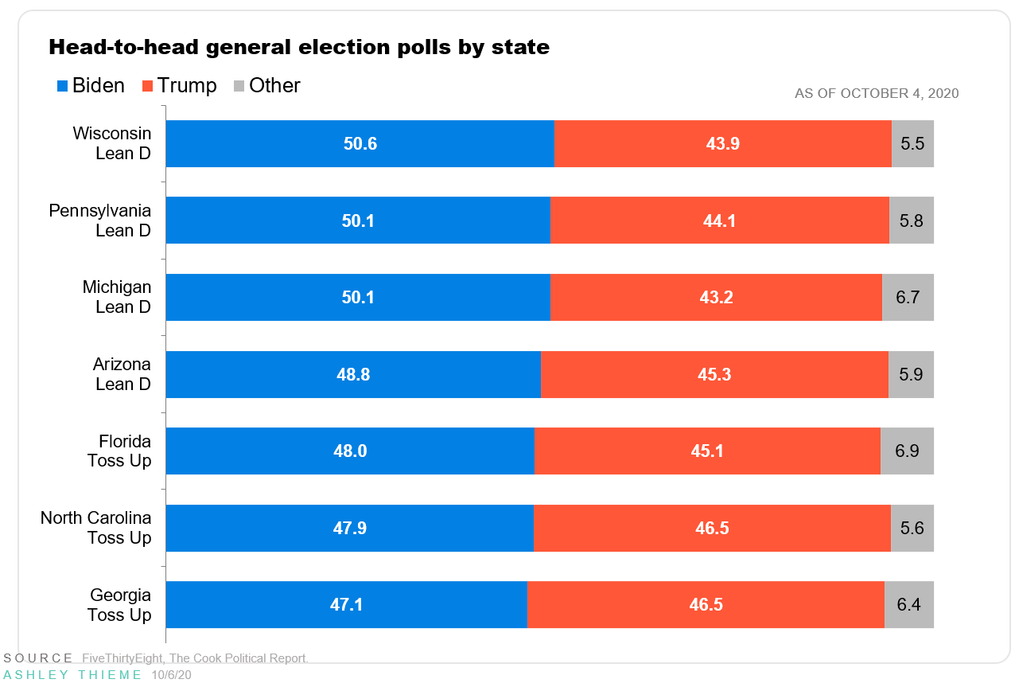
Where Polls are the Closest 26 Days From Nov. 3

Slide 22
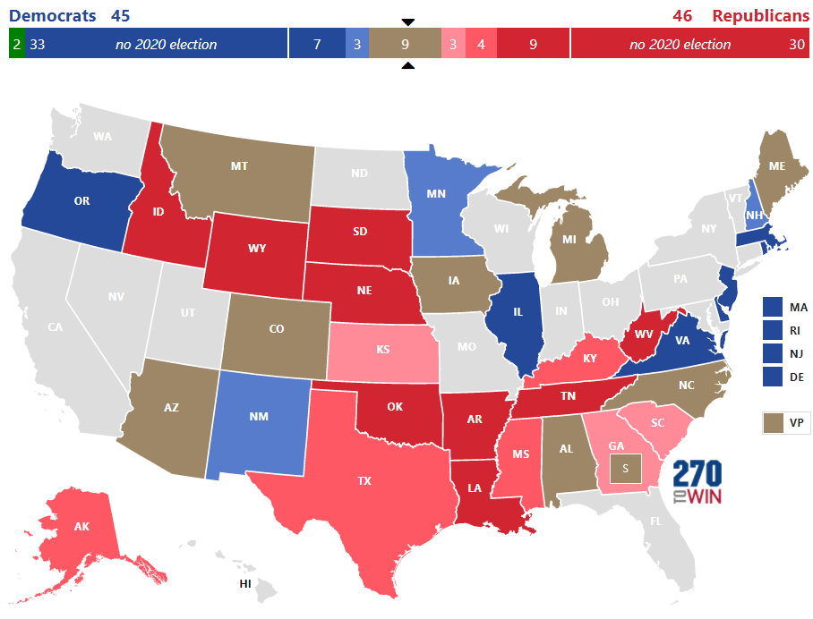
Senate Map – Currently 53 GOP – 47 Democrats
If Biden wins, Democrats must net 3 Senate seats to take control
If Trump wins, Democrats must net 4 seats to take control
Democrats likely lose Alabama, hold Michigan
GOP likely loses AZ and CO
Democrats need 3 of: MT, IA, GA, NC, ME if Trump wins

Slide 23
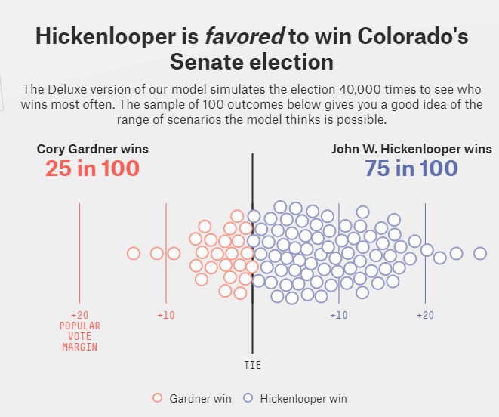
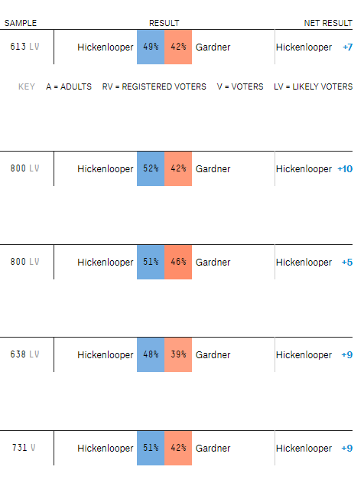
Colorado Senate Race: Rated as Leans Demcrat

Slide 24
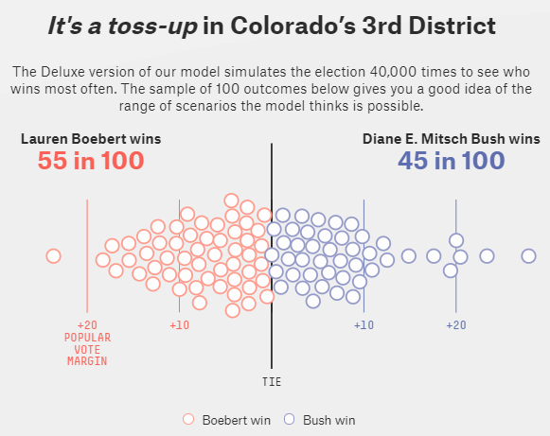
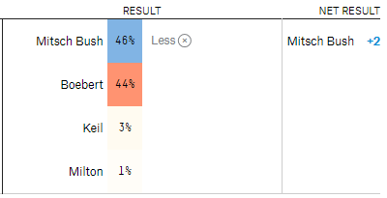
CO-03: Rep. Tipton Retiring; Leans GOP
Trump won this Congressional District 52% - 40%
In 2018, Tipton defeated Mitsch Bush 51.5% - 43.6%

Slide 25
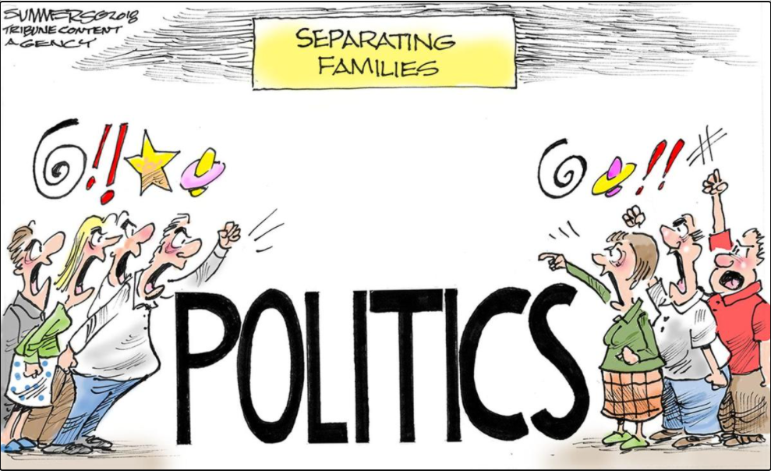
We Are All Tired of Politics…

Slide 26
…Politics Drives Policy that Affects Your Jobs, Lives
Make sure businesses don’t react too quickly to COVID proposals
Understand realities of proposals becoming law, manage expectations
Know what a President can do, recognize when Congress must act
Trump likely content with status quo on trade, tariffs, China after elections
Do not expect much change toward China under Biden on tariffs
Biden will quickly seek to address disputes with Europe, remove tariffs
Even if Trump wins, he will likely need Democrats on 2021, 2022 expiring tax provisions
Biden will be under tremendous pressure to undo tax law, expect increase in some rates
If voters see election as referendum on Trump handling of COVID, Biden likely wins

Slide 27
Questions?
Omar S. Nashashibi,
Founding Partner
The Franklin Partnership, LLC
Omar@franklinpartnership.com

