Slide 1

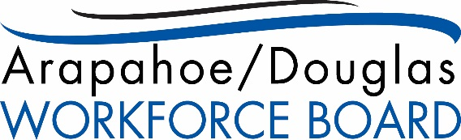
Rocky Mountain Tooling & Machining Association
October 8, 2020

Slide 2
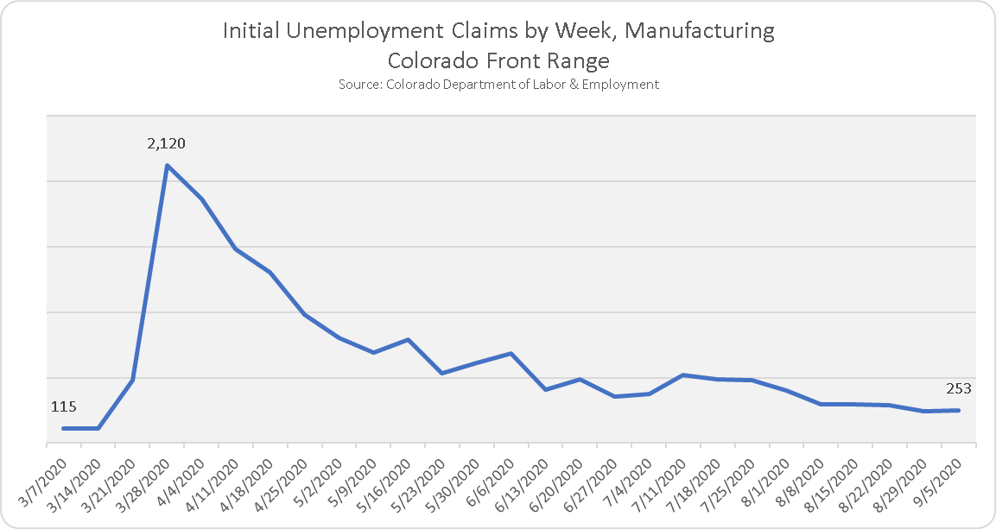
Pandemic Effects on Manufacturing
Manufacturing statewide experienced its main pandemic spike, as did other industry groups, the week ending March 28, 2020. To put this in perspective, there are 158,480 jobs in manufacturing statewide.

Slide 3
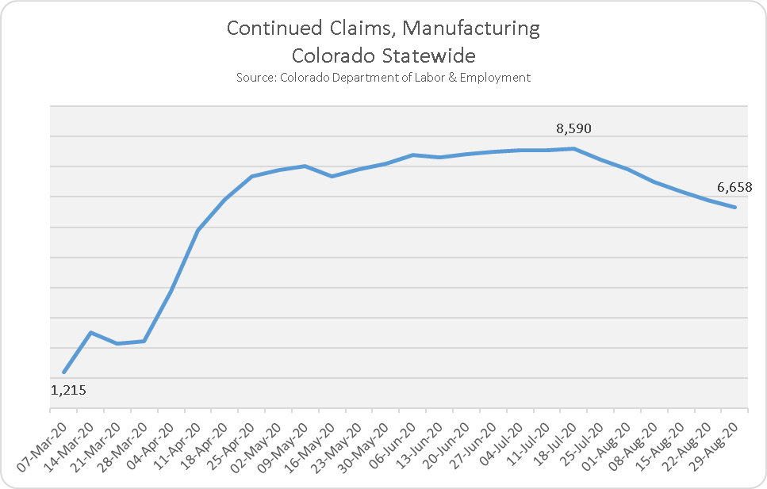
Current Effect on Manufacturing
Statewide, at the outset of 2020, there were 157,598 people working in the manufacturing sector.
As of September 5, 2020, there were still 6,658 jobless workers in all manufacturing statewide. This is about 4.2% of the manufacturing labor force in Colorado.

Slide 4
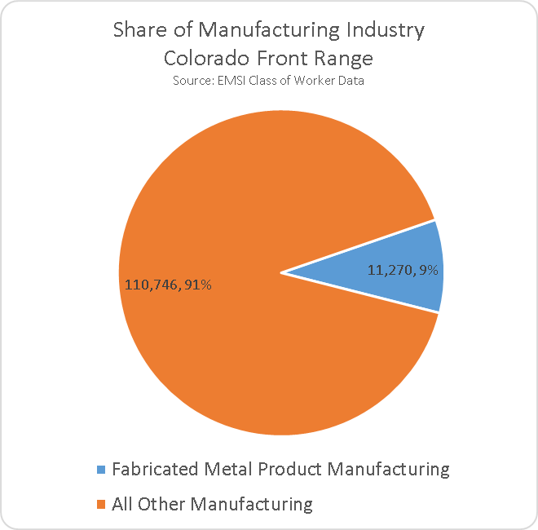
Sector Position
In 2019, Front Range manufacturers had total sales of $44.1 billion.
The same year, fabricated metal product manufacturers had total sales of $3.0 billion (6.3%).
Fabricated metal product manufacturing has a 2.34 job multiplier, which means that the industry group supports an additional 15,000 jobs along Colorado’s Front Range.

Slide 5
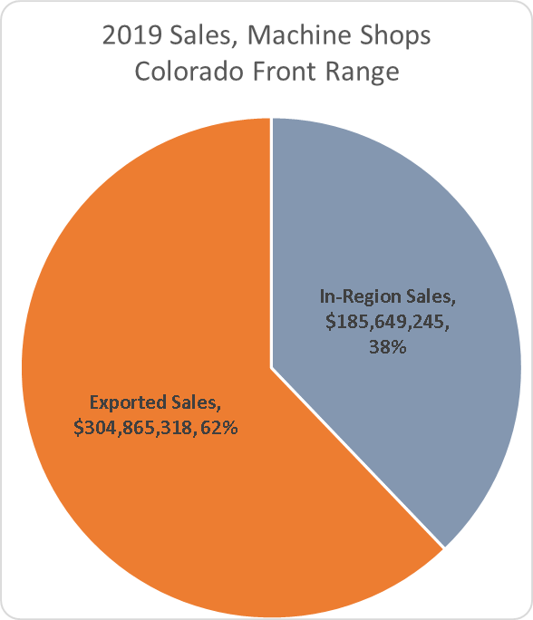
In-Region Sales by Industry

Slide 6
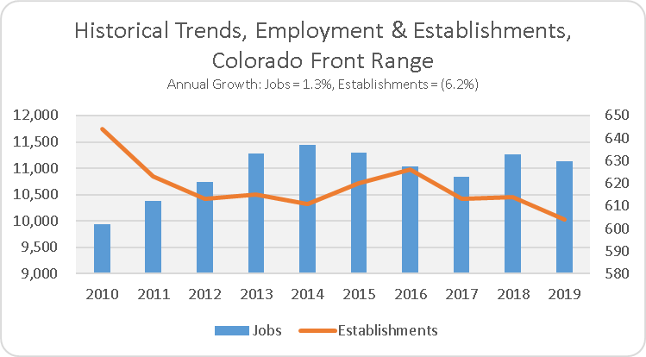
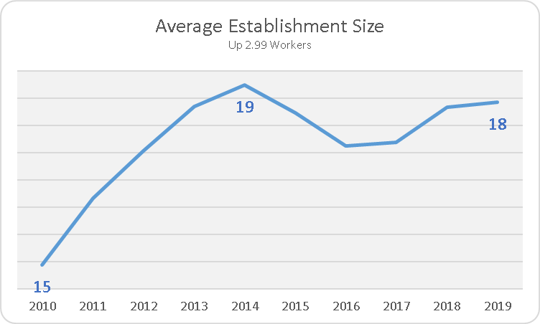
Historical Trends
Employment in the fabricated metals industry group, to which machine shops belong, has grown more slowly than overall employment (2.6% annually) along Colorado’s Front Range.
There also seems to have been some consolidation in the industry during the recession at the beginning of the decade, and then trending down from a peak in 2016.
The average establishment size was 15 people in 2010, and 18 last year.

Slide 7
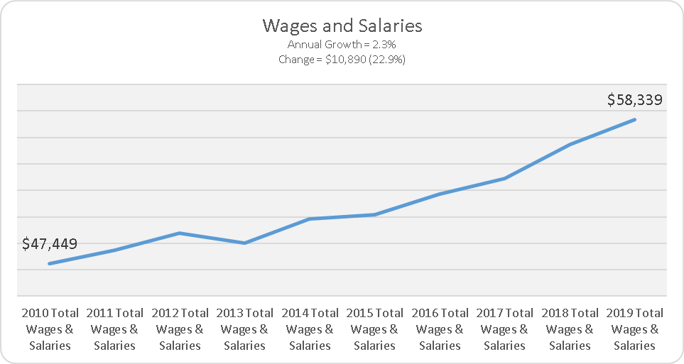
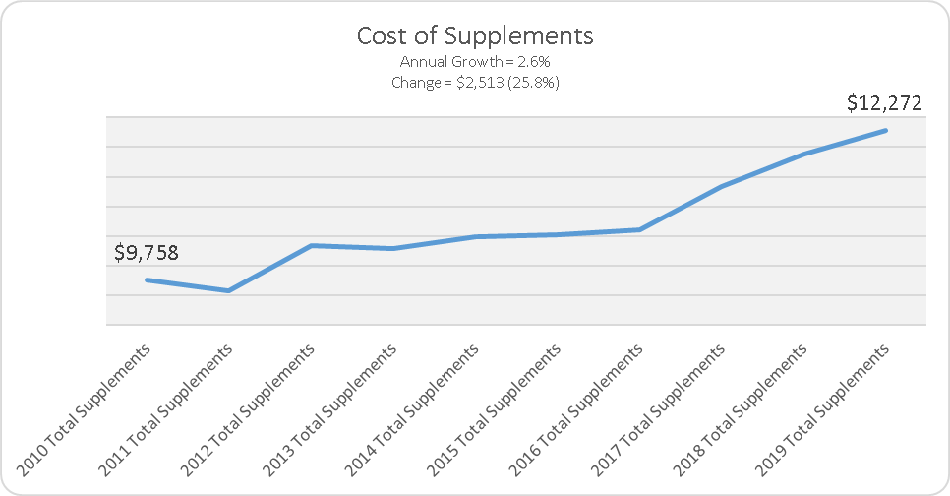
Trends in Pay & Benefits
Cost of supplements, driven by healthcare, have gone up faster over the last decade than salaries and wages.
The annual cost of healthcare to US businesses has gone up 3.2% annually between 2015 and 2020, according to Statista.
The Society for Human Resource Management (SHRM) projects up to a 6% increase in the cost of healthcare to employers this year.

Slide 8
Industry Projections
Employment in the fabricated metals industry group is expected to grow more slowly than the overall average. The Location Quotient is the employment concentration in the industry relative to the national average. So, taking the machine shops row, you would read, “Employment concentration in machine shops along Colorado’s Front Range is only 51% (just over half) of the national average employment concentration in that industry.”
Notes:
Mention the LQ and talk about room for growth in the industry group on the Front Range

Slide 9
Staffing Pattern

Slide 10
Regional Wages

Slide 11
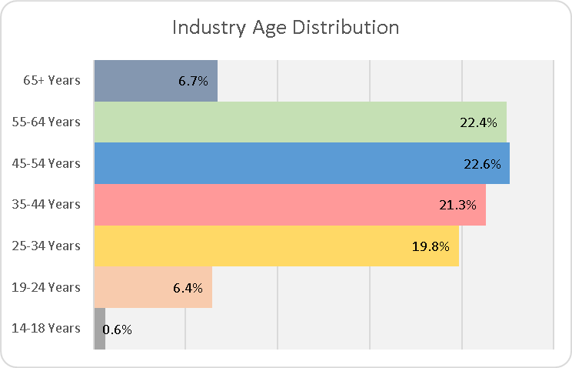
Retirement Risk
This industry group is age-imbalanced.
29.1% of the workforce is over 55, and 6.7% are 65 or older. This is offset against 26.9% 34 and under, leaving an imbalance of 2.2%.
This means that you have an immediate retirement risk of around 9% of your total workforce.

Slide 12
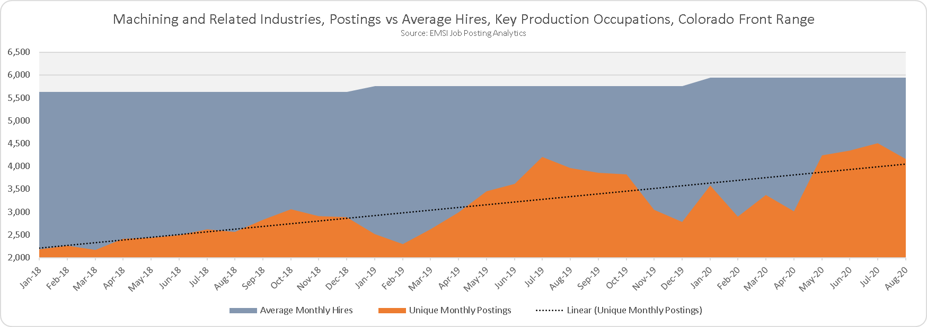
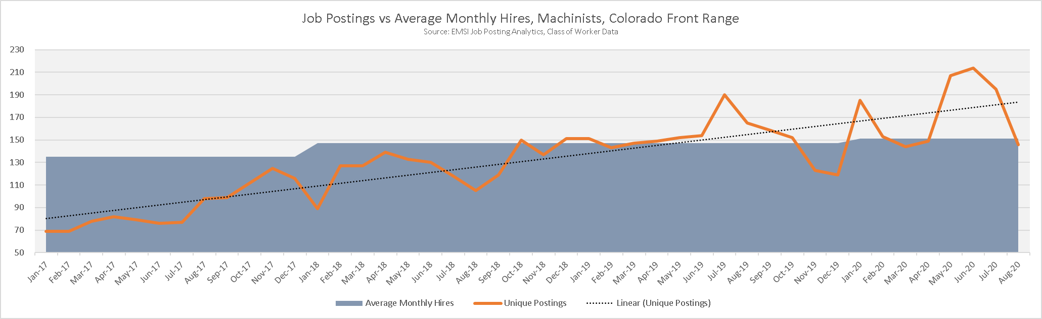
Job Postings History
Notes:
Call attention to the relationship between orange line and blue background on lower table

Slide 13
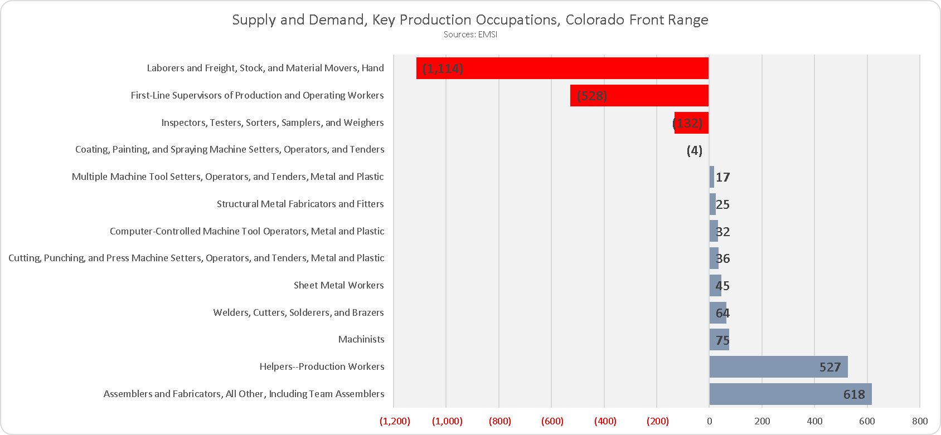
Skill Gap
Since the pandemic began, we have found that there is a skills gap between the people currently unemployed and available for work versus what businesses are demanding. We are seeing shortages of some types of workers due to demand outpacing supply. Note that supply is generally tight for all key production occupations except the two on bottom.

Slide 14
Job Titles and Skills in Recent Postings

Slide 15
Your Competitors for Key Staff
Notes:
The table to the left shows competitors for all key production occupations, and the one on the right is machinists and welders. Note differing timeframes. I had to go 365 to be meaningful for machinists and welders.

Slide 16
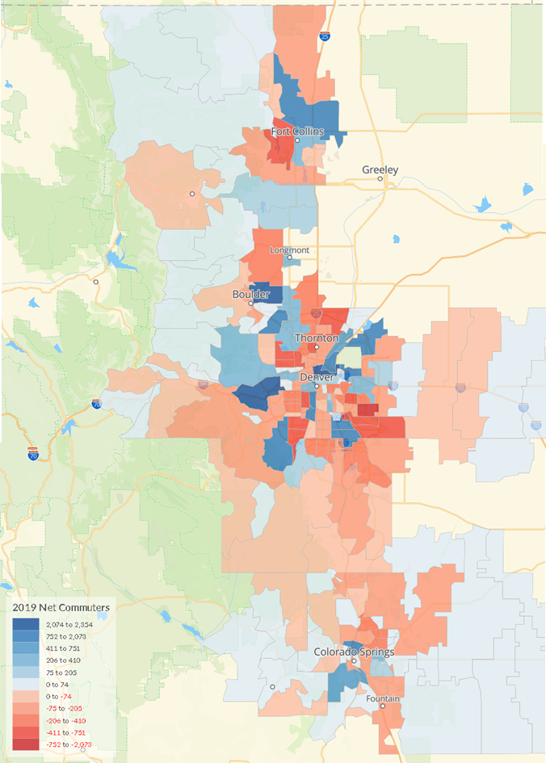
Where the Jobs Are and Where the Workers Live

Slide 17
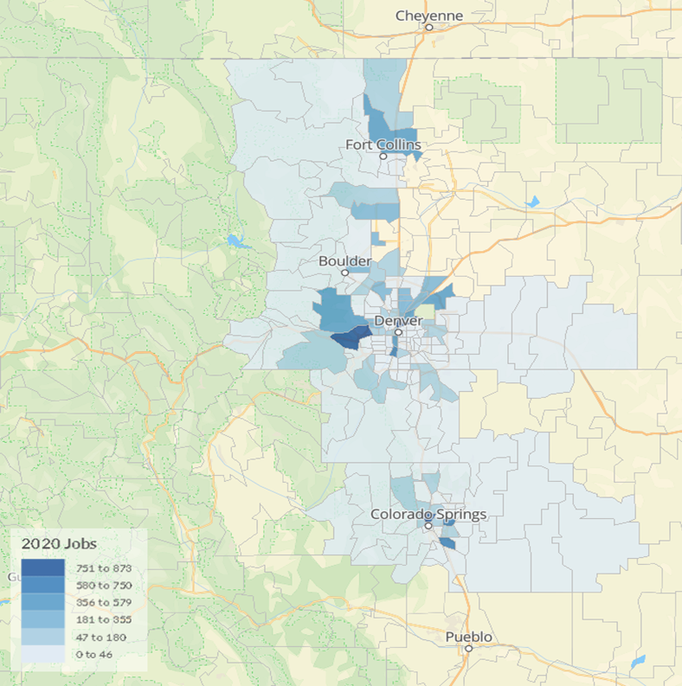
High Employment Concentrations

Slide 18

Opportunities for the Future
Workforce
Cooperating around training pipeline.
Mitigating retirement risk.
Workforce Boards
Apprenticeships
Regionalism
Growing Business
Colorado Spaceport and Aerospace
Medical Device Manufacturing
AI – The Internet of Things
Clean Energy and EVs

